Slide 1

Hibernate
Presented by:
Samundar Singh

Slide 2
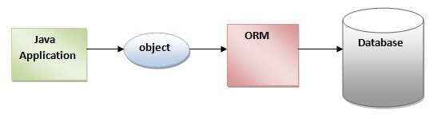
Introduction:
Hibernate is a Java framework that simplifies the development of Java application to interact with the database
It supports ORM(Object-relational mapping). It is a programming technique that maps the object to the data stored in the database.
It means that our program became independent from various database software.

Slide 3
Advantages :
Open Source and Lightweight:
Hibernate framework is open source under the LGPL license and lightweight
Fast Performance:
The performance of hibernate framework is fast because cache is internally used in hibernate framework
Database Independent Query:
HQL (Hibernate Query Language) is the object-oriented version of SQL which generates database independent queries.it means we don't need to write database specific query.
Automatic Table Creation:
Hibernate framework provides the facility to create the tables of the database automatically. So there is no need to create tables in the database manually.
Provides Query Statistics and Database Status
Hibernate supports Query cache and provide statistics about query and database status.

Slide 4
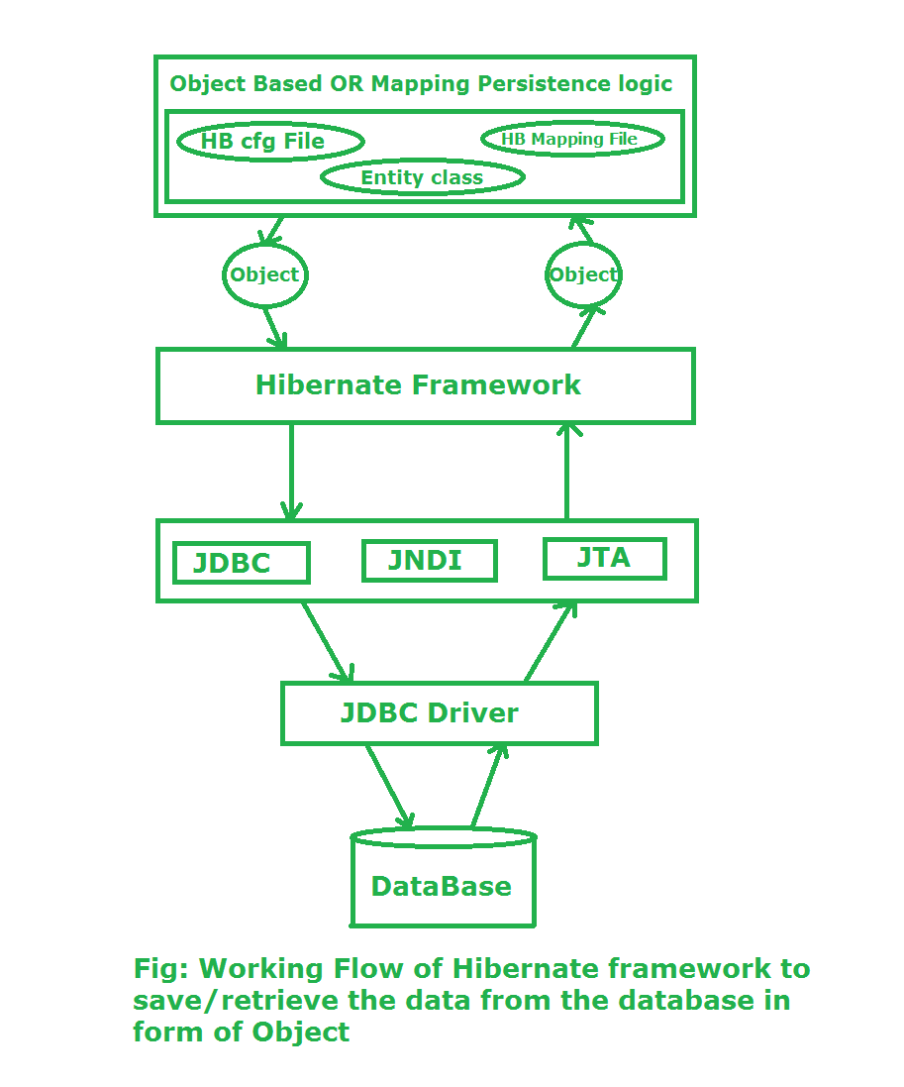
Work flow :
Diagram from geeksforgeeks.org

Slide 5
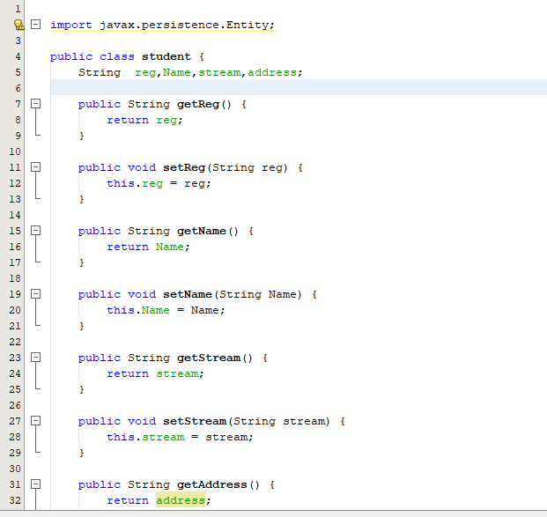
Implementation
Student.java
Here we create get and set method of all variables
Step I:
First we have to create a POJO class depending on the application that will be persisted to the database
POJO(Plain Old Java Object):
It is an ordinary Java object, not bound by any special restriction it basically defines an entity
It is a class that has getter and setter method for each entity that is going to map in database.

Slide 6
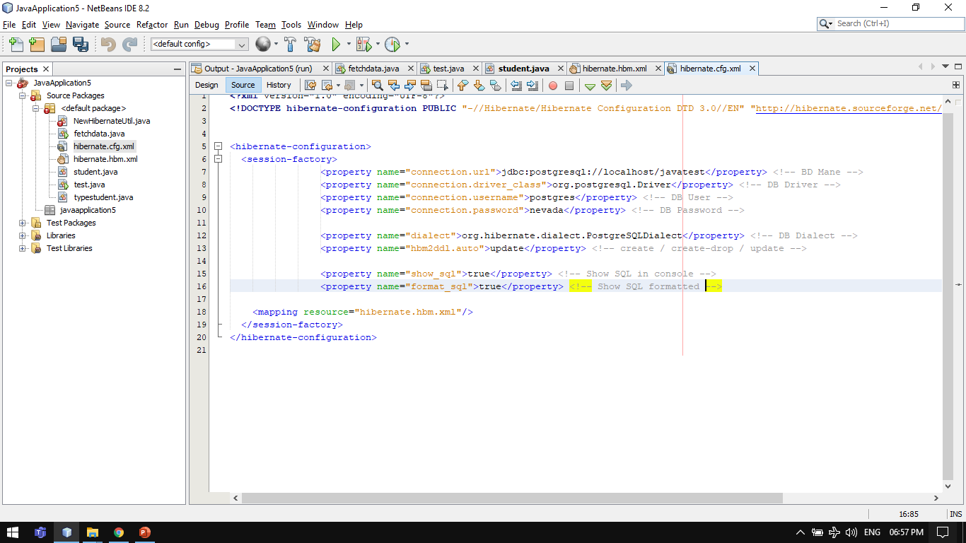
Implementation
This lines establish connection with the database hosting on particular port.
This command create table automatically when file is executed .
(if there is no such table in DB)
Step II:
Create the configuration file
This contains information about the database and mapping file .
The file must be saved with XYZ.cfg.xml format
Here we have to mention the dialect. The dialect specifies the type of database used in hibernate so that hibernate generate appropriate type of SQL statements.
hibernate.cfg.xml
These lines show the SQL query in the console

Slide 7
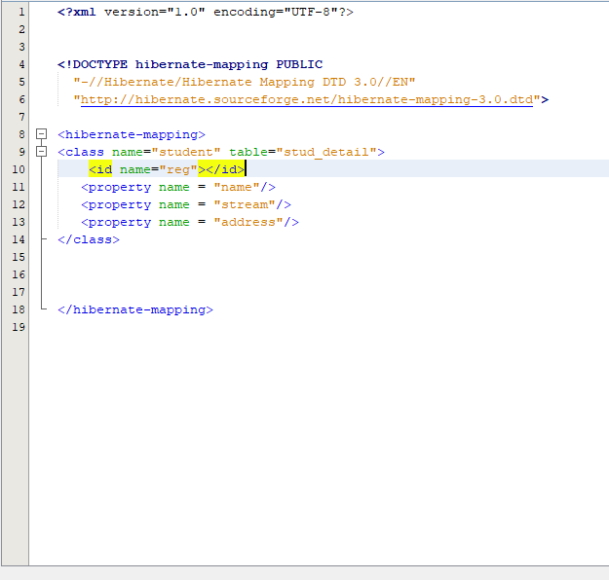
Implementation
hibernate.hbm.xml
Here mention the table name that you want to kept
Step III:
Create mapping of the persistent class.
Here it will map the defined class with the database.
The file must be saved with XYZ.hbm.xml format
Inside the id write the primary key
Inside the property write the name of table attribute

Slide 8
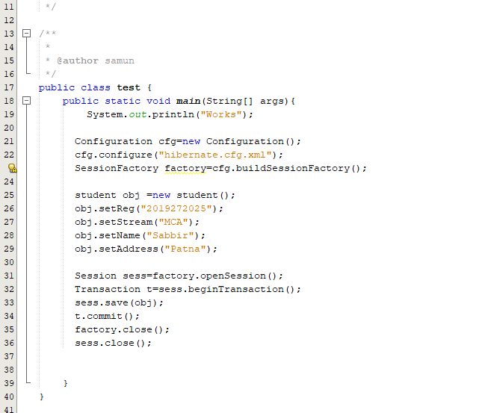
Implementation
Test.java and fetch.java
Step IV:
Create class that create the object
This class has the main method and it create the object of POJO class and sent it to the hibernate framework
Here object is created and using set method various entity(behaviour) is created.
These are the command that call various API of hibernate framework and map the object to the database

Slide 9
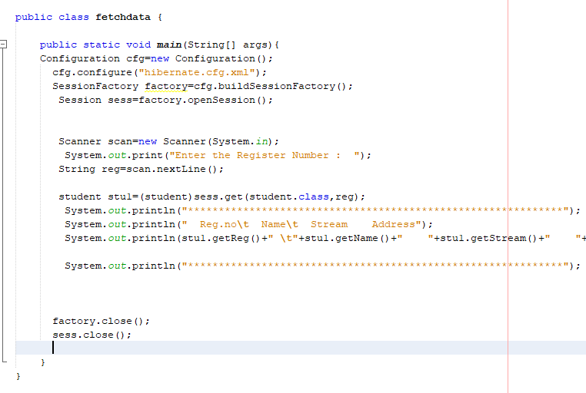
Implementation
Test.java and fetch.java
continue…..
Create class that retrieve or store the object
Similarly here object is retrieve from hibernate framework.

Slide 10
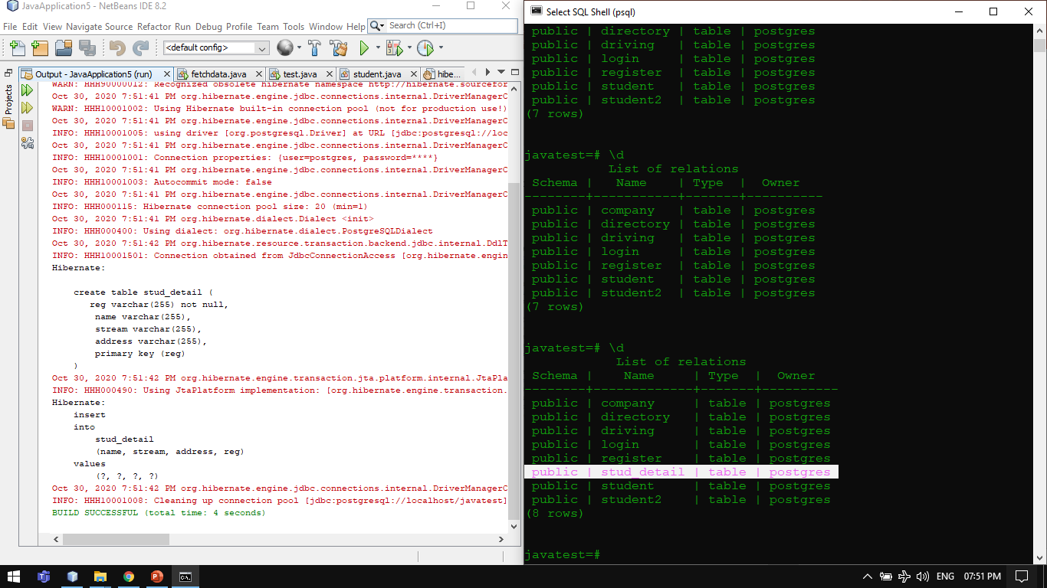
Output:

Slide 11
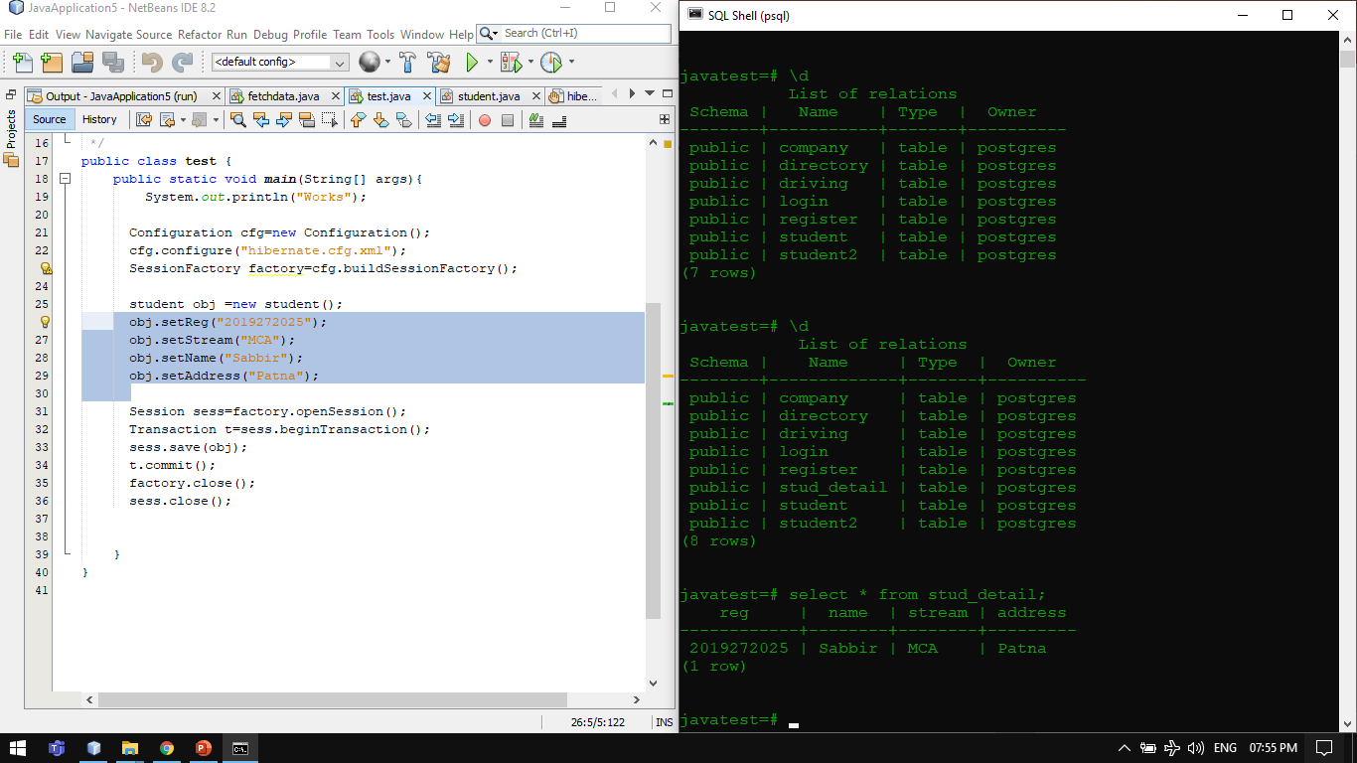
Output:
Go back to work flow
The object data mapped to database
This is object having some data

Slide 12
THANK YOU

